Slide 1
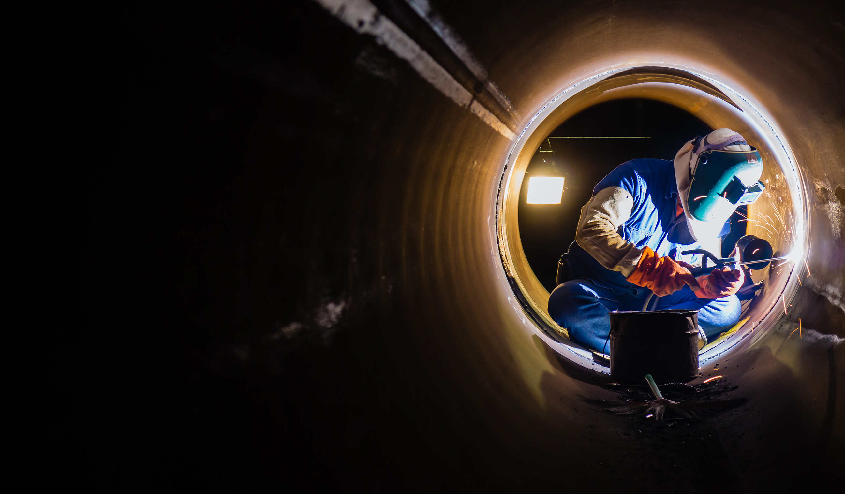


VIRTUAL REALITY WELDING TRAINING
CODED WELDER: OFO 651202-02
KM-01: INTRODUCTION TO THE WELDING TRADE NQF LEVEL 2, CREDITS 1

Slide 2

An Introduction to welding

Slide 3

ABOUT THIS MODULE
An introduction to the welding trade, covering employment and career opportunities, along with the requirements for becoming a certified Coded Welder.
Key learning outcome:
KM-01-KT01: Occupational profiles of welders (60%)
KM-01-KT02: Specialized welding related positions (10%)
KM-01-KT03: The welding ARPL trade test procedures and processes (5%)
KM-01-KT04: The work environment of a welder (25%)

Slide 4
Occupational profiles of welders
The welding industry encompasses diverse processes and applications, used in construction, manufacturing, aerospace, and more.
It offers various career opportunities, from inspectors to engineers, and continues to innovate.
Fundamental welding occupational profiles include roles like certified coded fillet welders, plate welders and pipe welders.

Slide 5
The fundamental welding occupational profiles
Certified Coded Fillet Welders | Certified Coded Plate Welders | Certified Coded Pipe Welders
Specialize in fillet welding, creating strong welds joining metal edges. Typically used for T-joints or lap joints. | Specilises in joining metal plates through various techniques to create durable welds. Crucial in construction, manufacturing, and infrastructure industries. | Specialize in joining metal pipes using advanced techniques for secure, reliable welds. Pipe welders ensure that welds meet quality standards, ensuring system functionality and durability.
Responsibilities - Read and interpret technical drawings. Select suitable welding methods. Prepare materials and surfaces. Perform fillet welds. Ensure fusion and appearance. Conduct inspections. Adhere to codes and safety. | Responsibilities - Read technical drawings and specifications. Select welding methods. Prepare plates. Perform plate welding. Ensure fusion and quality. Conduct inspections. Adhere to codes and safety. | Responsibilities Read technical drawings and specifications. Select welding methods. Prepare pipes. Perform pipe welding. Ensure fusion and quality. Conduct inspections and NDT. Adhere to codes and safety.

Slide 6
Skills needed for welding include:
Knowing welding rules, standards, and safety precautions.
Being good at different welding methods.
Reading and understanding technical drawings.
Show excellent use and understanding of welding equipment.
Being precise and detail-oriented in welding.
Having good hand skills and coordination.
Knowing about different metals and materials.
Communicating well with the team and understanding projects.

Slide 7
Becoming a certified coded welder:
Individuals usually train, gain experience, and get certified by industry bodies to prove their welding proficiency.
As welders gain expertise, they can advance to roles like supervisor or inspector.
Staying updated with welding tech advancements can open doors to better career opportunities and higher earnings.

Slide 8
Coded Welder Employment Opportunities
Fillet Welders
Construction, manufacturing, and infrastructure industries.
Plate Welders
Shipbuilding, construction, and manufacturing industries.
Pipe Welders
Oil and gas, infrastructure, and power generation industries.

Slide 9
Assessment Activity
Describe in your own words – the occupational profile of a fillet, plate and pipe welder personnel. Your answer should include the following:
a) Job description
b) How to quality
c) Work environment
d) Artisan Pathway

Slide 10
KT02: Specialized welding related positions
We will explore roles beyond the traditional welder, focusing on professionals who play essential roles in the welding industry.
These specialized positions are essential to ensure the quality, safety, and efficiency of welding processes across various sectors.
These include:
The International Welding Practitioner
The Occupational Trainer: Welding
The International Welding Specialist
The Welding Inspector
The Welding Technologist and Engineer

Slide 11
The specialized welding related positions
International Welding Practitioner
A specialized welding role that emphasizes practical application, quality assurance, and project management
It involves overseeing welding activities, ensuring international standards compliance, and maintaining top-quality, safe welds, requiring technical, leadership, and project management skills.
Occupational Trainer: Welding
The Welding Occupational Trainer plays a crucial role in educating and training future welders. They provide both theory and hands-on instruction to those aspiring to become welders.
The International Welding Specialist
Highly skilled professional with expertise in planning, executing, supervising, and testing welding operations within a specific technical field. They have in-depth knowledge of welding processes, standards, and quality control.
Their responsibilities include curriculum design, training delivery, progress assessment, and ensuring welders acquire industry-relevant skills.
The IWS is essential for ensuring welding projects meet international standards, specifications, and maintain high-quality welds

Slide 12
Welding Inspector
The Welding Inspector holds a vital role in assuring the quality, safety, and adherence to standards of welded structures and components.
They verify that welding processes and procedures meet established codes, preventing defects and upholding structural integrity. Employed in various industries, Welding Inspectors ensure projects comply with industry regulations while maintaining high welding quality.
Welding Technologist and Engineer
A Welding Technologist and Engineer is a professional with expertise in welding processes and applications. They plan and design welding projects, ensure weld quality, and often innovate in welding technology. They also prioritize safety, manage projects, and adhere to standards, playing a crucial role in welding across industries.
They plan projects, ensure weld quality, innovate in welding tech, prioritize safety, and manage projects. Their role is pivotal in various industries.

Slide 13
Assessment Activity
Briefly describe the responsibilities/role/s of the following personnel associated with the welding industry:
The International Welding Practitioner.
The Occupational Trainer: Welding.
The International Welding Specialist.
The Welding Inspector.
The Welding Technologist and Engineer

Slide 14
KT03 The welding ARPL trade test procedures and processes
We explore the Welding ARPL (Assessment of Prior Learning) Trade Test Procedures through different aspects of assessing and recognizing prior welding skills and knowledge.
Understand how the ARPL trade test works, eligibility criteria, test procedures, and the overall process. This knowledge highlights the significance of assessing prior learning in welding and its impact on skills recognition.

Slide 15
The welding trade test and eligibility requirements
In South Africa, welding apprentices face legal restrictions outlined in the Skills Development Act, specifically Act No. 97 of 1998 and its amendments, particularly Amended Act No. 37 of 2008.
These laws chart the path to becoming a certified artisan in the country.

Slide 16
According to Section 26D of Act No. 37, individuals have the right to apply for a trade test if they meet certain criteria:
If the individual has successfully completed a learnership relevant to the specific trade; or
If the individual has met the necessary requirements of an apprenticeship program related to that trade; or
If an accredited trade test center has confirmed that the person possesses sufficient prior learning in connection with the trade; and
If the individual holds an occupational or vocational qualification with the required work experience, they qualify. Occupational qualifications are registered with SAQA, and Vocational qualifications are registered by the Department of Higher Education and Training for TVET institutions.

Slide 17
The difference between the two main learning program within the welding occupation:
A qualified welder holds a South African welding qualification, as demonstrated by a certificate issued by the Quality Council for Trades and Occupations (QCTO).
- A skilled welder obtains a "Red Seal" by completing apprenticeships, learnerships, or ARPL, and passing a Trade Test.
A certificated (coded) welder is endorsed by a company, indicating their competence in producing welds that meet national or international standards (such as SANS, ASME, DIN).
- Someone who is authorized to perform welding using a particular welding method has their qualifications recorded and endorsed by their employing company.
However, these programs differ as per national or international standards.

Slide 18
When considering national or international standards, it's important to recognize that each country has its own set of standards. Understanding these distinctions and international standards is crucial in welding for ensuring quality and safety.
South Africa uses SANS (South African National Standard).
The USA follows ASME Boiler and Pressure Vessel Code Section IX, important in the petrochemical industry. AWS (American Welding Society) oversees welding in the USA.
Germany adheres to DIN (Deutsch International Norm).
The UK uses BS EN ISO Standards because of its connection with the European Union.
Australia and New Zealand use AS/NZS standards.

Slide 19
Welding Trade Test and Eligibility as per the South African standards:
The existing regulations governing the welding trade test, specifically the Trade Test Regulations of 2015, outline the criteria that South African citizens must meet to participate in the welder's trade test.
Eligibility for the trade test is contingent on considering the distinct pathways.
The table below provides a concise guide on meeting the requirements for the trade test, facilitating the journey toward achieving "Red Seal" qualification.

Slide 20
Table of access to Trade Test (Minimum Academic Requirements)
Academic Criteria | Learnership NQF L3 | Learnership NQF L4 | Apprenticeship | ARPL | NCV | NOC QCTO
Technical Matric (2 technical subjects) | Optional | Optional | Optional | √ | Optional | Optional
NQF L3 | √ |  |  | Optional
NQF L4 |  | √ |  | Optional
NATED 191 – N2 x 4 subjects |  |  | √ | Optional
Diploma (N6) |  |  | Optional | Optional
NCV Level 3 |  |  |  | Optional | √
NCV Level 4 |  |  |  | Optional | √
NOC (Occupational) |  |  |  | N/A |  | Complete
Apprentice Modules |  |  | √ Phase1-4 | Optional

Slide 21
Table of access to Trade Test (Minimum Workplace Experience Requirements)
Work experience | L/ship NQF level 3 | L/ship NQF level 4 | App ship | ARPL | NCV | NOC QCTO
18 months | N/A | With contract | With contract | With n6 / NCVL4 | √ NCVL4 | N/A
3 years | Without contract | Without contract | N/A | Without training | √ NCVL3 | √ 3 years inclusive

Slide 22
Access to the welding trade test has three key categories of requirements:
Knowledge Requirements:
Learnerships: Complete theoretical assessments up to NQF Level 3.
Apprenticeships: Minimum N2 qualification with four subjects passed.
ARPL: Foundational learning equivalent to Grade 9.
TVET candidates (NCV) and NOC (QCTO): Completion of specified educational levels.

Slide 23
Practical Requirements:
Learnerships: Fulfill practical assessments up to a minimum of NQF Level 3.
Apprenticeships: Successfully complete Competency Based Modular Training (CBMT).
ARPL: Provide a portfolio of evidence demonstrating relevant experience or training.
TVET candidates (NCV) and NOC (QCTO): Finish practical modules as per the curriculum.

Slide 24
Workplace Experience Requirements:
Learnerships: 18 months if contracted or 3 years if not contracted in a structured program.
Apprenticeships: Completion of the contract period (3 – 4 years).
ARPL: More than 3 years of workplace experience.
TVET candidates (NCV) and NOC (QCTO): Varies based on the educational level and program.

Slide 25
Assessment Activity
State the FIVE pathways to artisanship (access to the trade test). Describe the pathway in terms of the following:
a) Learning program
b) Learning program contents
c) Work experience requirements
d) Trade test process

Slide 26
KT04 The work environment of a welder
The work environment of a welder is a crucial aspect of their profession, impacting safety, efficiency, and overall job satisfaction. Here, we explore the key elements of a welder's work environment

Slide 27
Welding Career Opportunities Across Industries
Welding offers diverse career opportunities throughout various sectors of the South African economy. As discussed above.
The welder work ethics
Coded welders must adhere to a Code of Conduct outlined by the South African Institute of Welding (SAIW).
Additionally, as members of The Welding Institute, they are expected to follow the Institute's Code of Conduct and uphold the Engineering Council's Statement of Ethical Principles while performing their professional duties.

Slide 28
The Ethical Guidelines
a) Act with skill, care, and diligence, adhering to professional standards.
b) Exhibit competence in their work, evaluating, managing, and transparently communicating all relevant risks and limitations of their expertise.
c) Acknowledge the authority of their supervisors and assume responsibility for their work.
d) Assess and address liability, including obtaining professional indemnity insurance if necessary.
e) Evaluate and manage pertinent risks, communicating them effectively.
f) Provide objective and dependable professional advice when asked, to the best of their ability.
g) If their advice is rejected, they must inform the person and, when possible, document it.

Slide 29
Collective agreements that apply to the welding trade
Welders find themselves working within several industry contexts (environments). As such each industry sector has one or more labor or trade union which looks after the interests of workers in terms of the following:
• Employment conditions;
• Career pathway; and
• Salary scales
When unions and employers in an industry jointly agree on these aspects, it's called a "collective agreement" for mutual understanding and acceptance.

Slide 30
Examples of different industry environments include:
Chemical industry with trade unions like CEPPWAWU, SOLIDARITY, SACWU, and GIWUSA.
Mining industry with NUMSA, NUM, and SOLIDARITY.
Metal and Engineering Industries with NUMSA in the Metal and Engineering Industries Bargaining Council.
Collective bargaining is crucial for labor relations and unions play a pivotal role in this process.

Slide 31
Some of the industry environments impacts examples to discuss
Collective bargaining's role in industrial relations.
Impact of South African economy and COVID-19 on union bargaining.
Trade Unions securing above-inflation wage increases.
Challenges posed by rising commodity prices.
Public sector wage freezes and disputes.
2021 wage demands and government offers.
SAMWU's clashes with SALGA over wage demands.

Slide 32
Assessment Activity
Define what is meant by the term “Collective Bargaining Agreement”?
Briefly explain each of the member’s obligations to the Code of Conduct in respect of the Coded Welder’s professional relationships with employers, colleagues, or clients.
Bribery and all forms of corrupt behavior
Changes in professional status
Violation of the Code of Conduct by another member
When is a member guilty of improper conduct?
On becoming bankrupt.

Slide 33

The End

